Slide 1
Africa Before, During and After Colonization
A Brief Overview
Notes:
Source: http://howafrica.com/the-map-of-africa-before-colonisation-look-at-what-has-become-of-it-now/

Slide 2
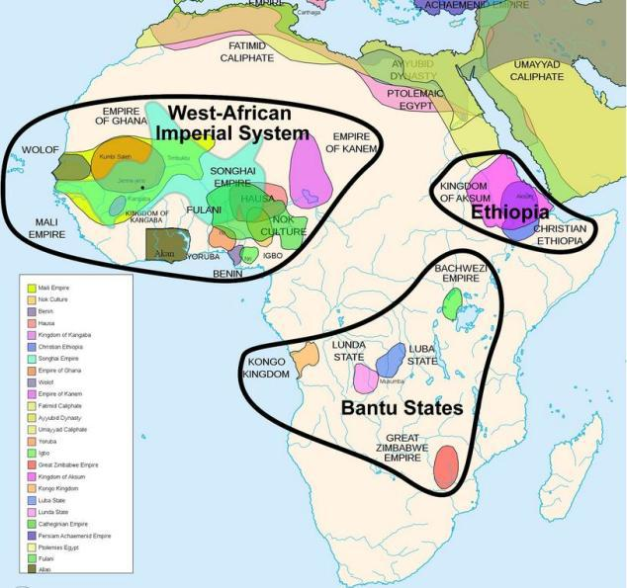
Before Colonization
A lot of these pre-colonial states formed between 1500-1600
Notice borders
- different than today
- overlap of kingdoms, cultures, etc.
- suggests fluid borders

Slide 3
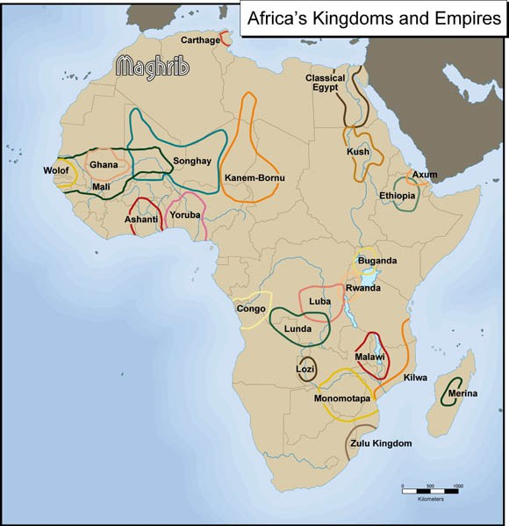
Before: Africa’s Kingdoms and Empires
Some didn’t get along.
Conflict
Abductions → slavery

Slide 4
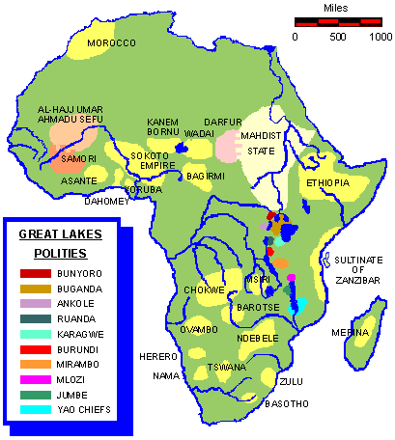
Before

Slide 5
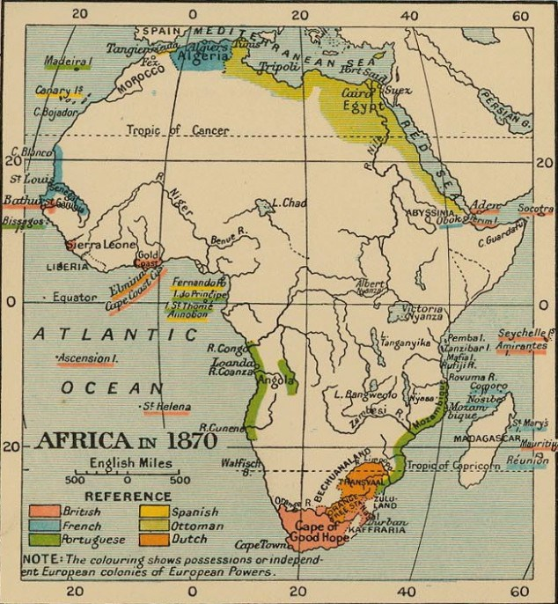
Map showing Africa in 1870, still largely uncolonized except for small areas of possessions or independent European colonies illustrated by the coloring.

Slide 6
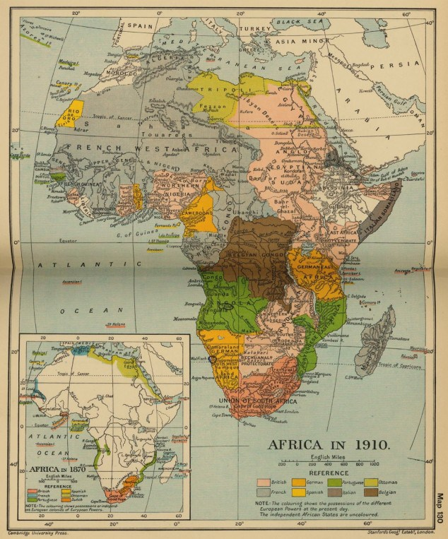
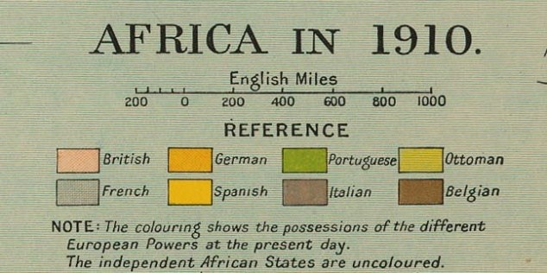
During
larger part of Africa colonized in 1910.

Slide 7
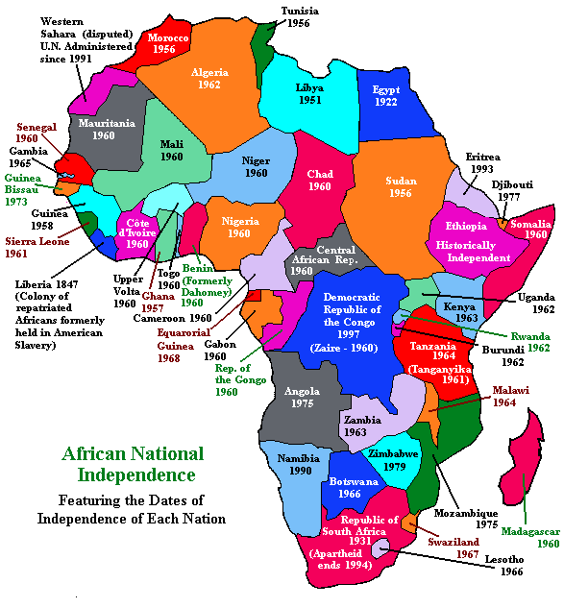
After
What do you notice about the borders?
Compare these to pre-colonial borders
Similarities?
Differences?
Why do you think these borders resemble colonial borders?
Predict: What impact will these borders have?
P
E
G
S
Will the impact be positive or negative?

Slide 8
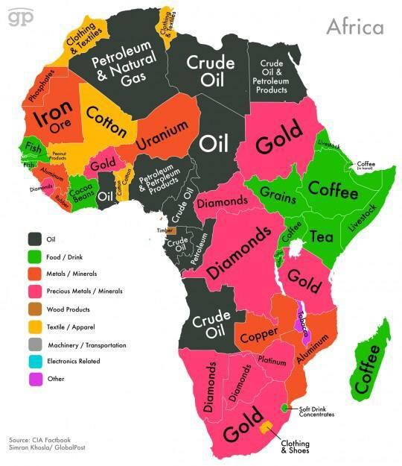
After
What is this map telling us?

Slide 9
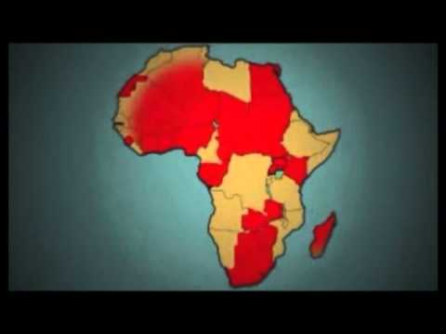
Brief Overview of the Colonization of Africa

Slide 10
My thoughts….
Imperialism drives colonization
Justified by what colonial powers are giving to colonies (not what they’re taking)
Technology, Railroads, Christianity, Education, Civilization
Capitalism drives colonization
For new markets (new, more buyers) & new/more resources (raw materials and labor)
But actually crony capitalism to keep Euros in power above Africans (and maintain their hold over territory)
Invention of race theory & racism by Germans (other Euros - not all - adopt it)
Preliterate; different cultures that are subsistence based and heavily tied to witchcraft; cannibalism; female circumcision; polygamy
Where Social connects with Geographic, Economic, and Political
Can’t own certain lands in S. Africa
Coerced to do wage labor (not subistence farming) for low wages
Nonviolent - keeping from land owning, marketing & social pressure for new consumer goods (British)
Violent - beatings, whippings (Belgians)
Kept from having skilled jobs or professional jobs
Kept from borrowing from banks to invest in business, etc.
Kept from political participation, if there was any from the people at all
Missionaries
Education - literacy greatly expands aross continent
Spread of ideas and shared experiences...common desire grows to expel foreign colonizers later on
Double standards for Euros and Africans: Economic opportunity & Democracy

Slide 11
Primary Source Analysis
SOAPS - African Response to European and Ottoman takeover
Reflection:
What can you infer about the Africans - their thoughts, overall strategy?

Slide 12
Predictions: Impacts of Colonization
What Political impact/s do you think colonization had?
Economic?
Geographic?
Social?
Keep these in mind for your own case study of a formerly colonized country. HINT: write them down and come back to them to direct your research

