Slide 1
North America in 1700 & Growth, Diversity, and Region

Slide 2
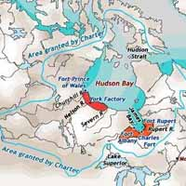
North America in 1700
Still an Indian majority but declining coastal incursions (2 mil by 1800)
More people coming to French Canada – soldiers and indentured servants, 6-60k growth
Paternal crown-directed militarized regime over peasantry
Voyageur expansion to Great Lakes
Hudson Bay Co.
Interdependence with Indians
Intermarriage and metis (spoke both languages, negotiators)

Slide 3
Attracted to life in “Indian country” – further west and south
Supported by crown subsidies
Run by attendant and monseigneurs (council)
No local officers
No elections
Est. forts, missions (Niagara, Detroit, St. Louis)
Refugee Indians between Lake Superior and Lake Michigan
Relied on beaver
Overran western Indians and resupplied lost warriors

Slide 4
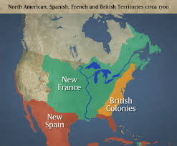
French Louisiana, 1700
Co. of Indies brought 5k-6k slaves to grow tobacco, rice, indigo
Soldiers, convicts, slaves
Mississippi plantations
Dependence on Creek, Choctaw allies to subdue the land and other tribes

Slide 5
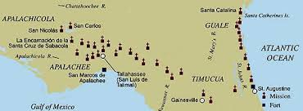
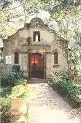
Spanish Florida and New Mexico, 1700
Missions
Settlements in 17th c (Santa Fe and Albuquerque)
Indian labor co-option to build communities
Captive exchanges of whites (kidnappings) to replace kin, heirs, warriors)

Slide 6
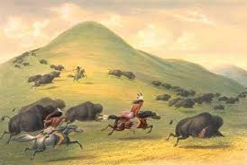
Impact on Indians of Great Plains, 1700
Apache, Comanche, Cheyenne, Lakota Sioux
Advance and intersection of southern horse and northern gun cultures → buffalo hunting nomadic societies
New wars and dislocations (plus disease decimation) ahead of white exploration and settlement

Slide 7
English in 1700s
Dramatic population, economic, and social growth
250k in 1700 → 1.6m in 1760 → 2.5m in 1775
1/3 from emigration (African, Germans, British, Irish, other), 2/3-3/4 from births (incl. black people)

Slide 8
Royal Government: Structure and Practice
Royal Governors and elected assemblies
Governor acts on crown’s instructions (trade, education, pirates), paid on commission
Ran the executive with a council
Served as legislature with assembly
Elected by adult, white, protestant freeholders (e.g., if you have a stake in the welfare of society)
50 acres or 50 lbs of property – 70-80% of white males had this b/c of headrights
Property owned = invested; independent thinkers
Not specifically banning women
Deference & choosing the best
Representation of property, not people
Based on the English Bill of Rights
Voted on taxes

Slide 9
English Political Hierarchy
King
Board of Trade (Advisory)
Parliament
English Electorate
Royal Governor
Assembly
Colonial Electorate

Slide 10
Growth of Assemblies
Assemblies grow in power as thru power of the purse and thus policy-making
Had free speech during session
Microcosm of Parliament
Division of powers:
Crown: trade, Indian affairs
Assemblies: local defense, taxation
Validation of elites’ decisions anyway (why?)
Bargained with Governor for money: if Gov does assembly’s will and assembly monitors spending
Gov had to cooperate to do his job (no regular salary)
His patronage of assemblymen not possible as they are incorruptible

Slide 11
The Mother and Daughter
Daughter – adopted opposition (Whigs) to limit govt, stress rights/liberties, criticize govt and caution against too much power in executive
Mother – mom’s will rules all
Divisions didn’t happen quickly or instantly. Both accommodating through 1690-1760s
Admired English constitution
Respected 1688 settlement
Unified in war with France and Spain
Sent over agents to facilitate wishes (Ben Franklin)
Maintained local self-government at the king’s command with assemblies and committees as training grounds for…

Slide 12
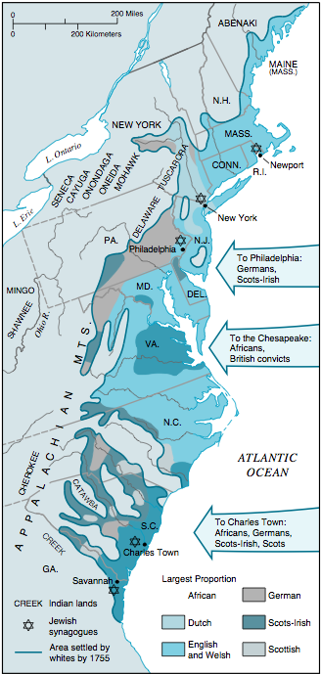
1700-60: Growth, Diversity, and Region
A composite empire
Negotiated authorities
Individual colonies with autonomy and direct relationship with England
Population increase (immigrant and slaves)
Economic and social growth
Differentiation/regionalization of colonies – plantation, back country, and urban societies
New patters and models of socialization

Slide 13
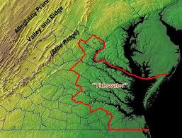
Plantation Region
Chesapeake/Carolina – 700k population
1/3 slaves
Mostly on large tide water units (e.g., Mount Vernon)
Non-industrial, non urban, no roads
Seasons according to crop seasons
VA elite – self-fashioned gentility; ties to England; inbred, leaders all related
Carolina – cruder but wealthier (rice, indigo, tobacco)
Harsh, unhealthy labor so owners removed selves to city to separate from slaves
Harder to qualify to be a politician (had to own more)

Slide 14
Plantation: Education
Valued
Many sent kids to England (later, would be suspected as damaging to kids) (e.g., Jefferson, Madison)
Built musical, cultural endeavors
House parties, dancing, affairs of honor and blood sports (duels, wrestling, fights), horse racing (England is the model)

Slide 15
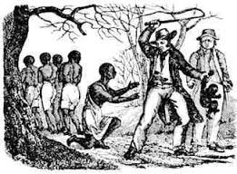
Plantation: Organization of Society
Religion’s influence: ministers and formal churches in coastal areas; no state church on the frontier
Slave labor: creole cultures; gang labor in Chesapeake; farm/urban service in north – cycles of slave importation, acquiring craft skills, tempering resistance
Problems of slave-holding and staple producing society:
Pride (and violence) in mastery
Growing debts of genteel living
Resentment for threats to personal autonomy and honor (England’s regulation and taxes)

Slide 16
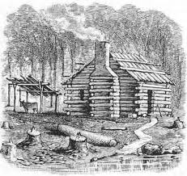
Backcountry Region
Northern frontier: Indian/French attacks and subsistence agriculture
Isolated from coast and its market
Necessity of defense for survival – nothing in leisure
Garrison towns: always on guard; made of logs for structural defense (few or no windows)
Bears and wolves
Grew maize, wheat, beans, squash, cattle pigs, apples, barley
Little effort in conservation; driven to keep moving west to find fresh land (or more for new frontier people)
Filling up backcountry from Pennsylvania – south in 18th c. – 1/4m people by 1776

Slide 17
Backcountry
Charles Woodsmason, Anglican minister in Carolina backcountry.
Wanted to reform character of frontier people (prejudiced)
Series of communities
People always moving; Shaped by Indian relations and conflict
Indians tried to live there but whites didn’t trust and attacked
Un-organized settlements (i.e., councils)
No capital to buy slaves; servants are a rarity
Organized around the family unit (kids contribute)
South frontier – Scots-Irish; uneducated, primitive, unchurched or Presbyterians/Baptists
Notes:
South frontier crops – same and also whiskey, rye, potato, tobacco, indigo, hemp; scots-irish = ethnic diversification from straight english

Slide 18
Backcountry
Hardly any govt- people had to travel to court to settle dealings (property)
S. Carolina: Formed vigilante govt “regulators” to govern people (whores, idle) → est. courts led by men who wanted to est. themselves
N. Carolina: “regulators” protested taxes, aristocratic cliques, lack of schools, and under-representation.
Petitioned govt to no avail; 1771 battle of Alamance bx Gov’s troops and regulators: Gov won, movement collapsed…evolved and reappeared in A. Revolution
Social (jobs, religion, community interrelations) and ethnic diversification

Slide 19
Urban Society
 | 1700 | 1740 | 1780
Boston | 8k | 17k | 16k
NYC | 5k | 9k | 26k
Phillie | 3k | 10k | 26k
Newport | 2.6k | 6.2k | 11k
Charleston | 2k | 6.5k | 12.5k
Mainland English Colonies | 250k | 900k | 2.7m
7% of population in towns over 2,500 in 1700 and declines thru 18th c.
A rural society
Towns important centers of trade, govt, society, and finance
Notes:
Not until 1920s would majority live in cities; finance = barter/commodities as currency but also coin (spanish pieces of 8 reales/dollar) and paper money in each colony

Slide 20
Towns
Development of constables
Crowding – frequent fires
No roads at first
Markets
Water – no running, pumps and intervals (lots of beer)
Sanitation – small px, typhoid (ships)
Flooding
Prostitution/brothels
Workhouse (i.e., welfare program)
Stocks and mutilation – punishment
Prisons (debtors)

Slide 21
Towns: Volunteerism and City Life
No formal infrastructure → we’ll take care of it
De ’Tocqueville’s observations
Phillie: Ben Franklin starts vol. fire service where vols pay to fund it; chimneys swept once a month: https://www.youtube.com/watch?v=vwQ2QByWpDY
Rise of voluntary acts: aid groups, education
Prosperity from mercantilism → leisure activities and (int’l) newspapers
Disparity bx rich and poor due to wars, death, econ. Depression.
10% owned 50% of wealth in the towns
Met with charity and morality tales: rewards of diligence (Ben Franklin)
Crowd expression in riots/protests (popular will) → organized resistance to authority
Food riots
Anti-property riots
Stamp act…
Notes:
Leisure: dancing, etiquette, coffee houses

Slide 22
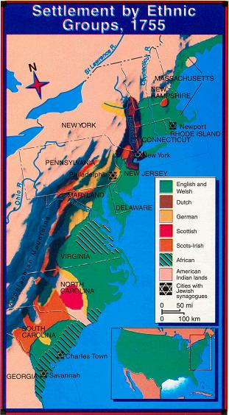
Where is each prevalent? Why?

Slide 23
Homework: Learn from 3 accounts
Madam Knight
Dr. Alexander Hamilton
Rev. Charles Woodmason
Read their accounts and reflect:
What does diversity look like in 1700?
Is there schism or divide between certain regions? Socio-economic classes?
How did self-autonomy manifest itself differently in each region?
Explain the development of American Identity as rooted in market economics, pluralism, volunteerism, and diligence, self-expression and self-governance.

